Slide 1
Classic McEliece
Progress Report of Last Week
2023.11.6

Slide 2
Synopsis
Classic McEliece KEM
Goppa Code
Unique Decoding with Berlekamp-Welch
Unique Decoding Algorithm by DJB
Unique Decoding with Derivative
Bad News from List Decoding

Slide 3



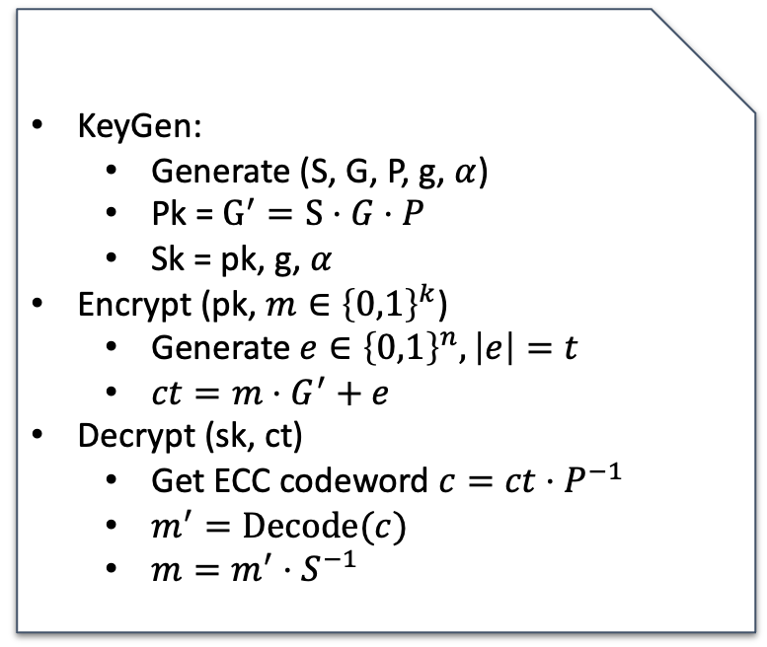



Original McEliece
Originally proposed by Robert J. McEliece in 1978
KeyGen:
Generate (S, G, P, g, $α$)
Pk = $G^{′}=S⋅G⋅P$
Sk = pk, g, $α$
Encrypt (pk, $m∈{\left\{0,1\right\}}^{k}$)
Generate $e∈{\left\{0,1\right\}}^{n},\left|e\right|=t$
$ct=m⋅G^{′}+e$
Decrypt (sk, ct)
Get ECC codeword $c=ct⋅P^{−1}$
$m^{′}=Decode(c)$
$m=m^{′}⋅S^{−1}$
McEliece PKE
P
G’
S
G
$$=$$
$$×$$
$$×$$
G’
ct
$$=$$
m
$$×$$
$$+$$
e

Slide 4
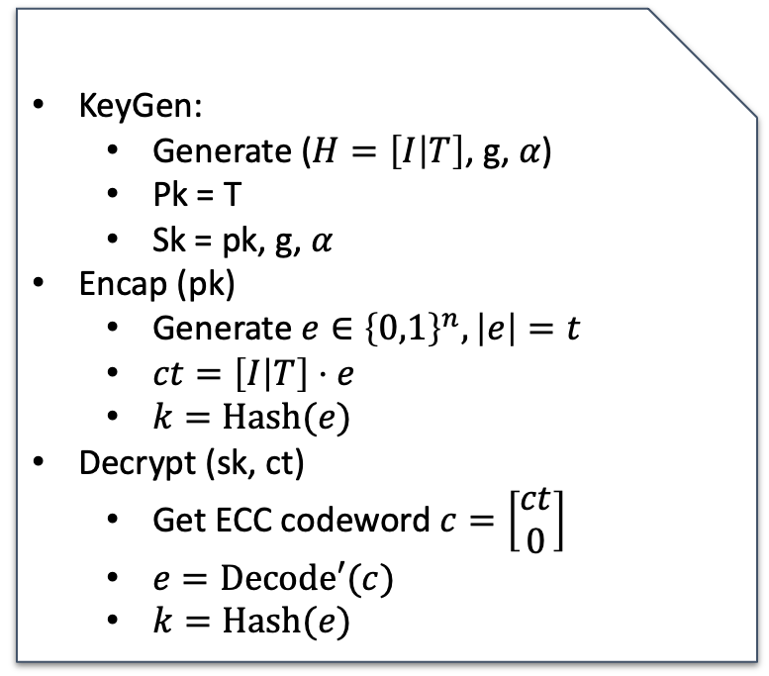
Classic McEliece
NIST PQC Submission
Dual-form (Niederreiter) of McEliece
Saves k-bit in ciphertext
KeyGen:
Generate ($H=\left[I | T\right]$, g, $α$)
Pk = T
Sk = pk, g, $α$
Encap (pk)
Generate $e∈{\left\{0,1\right\}}^{n},\left|e\right|=t$
$ct=\left[I | T\right]⋅e$
$k=Hash(e)$
Decrypt (sk, ct)
Get ECC codeword $c=\left[\begin{matrix}ct \\ 0\end{matrix}\right]$
$e=Decode′(c)$
$k=Hash(e)$
Classic McEliece KEM

Slide 5
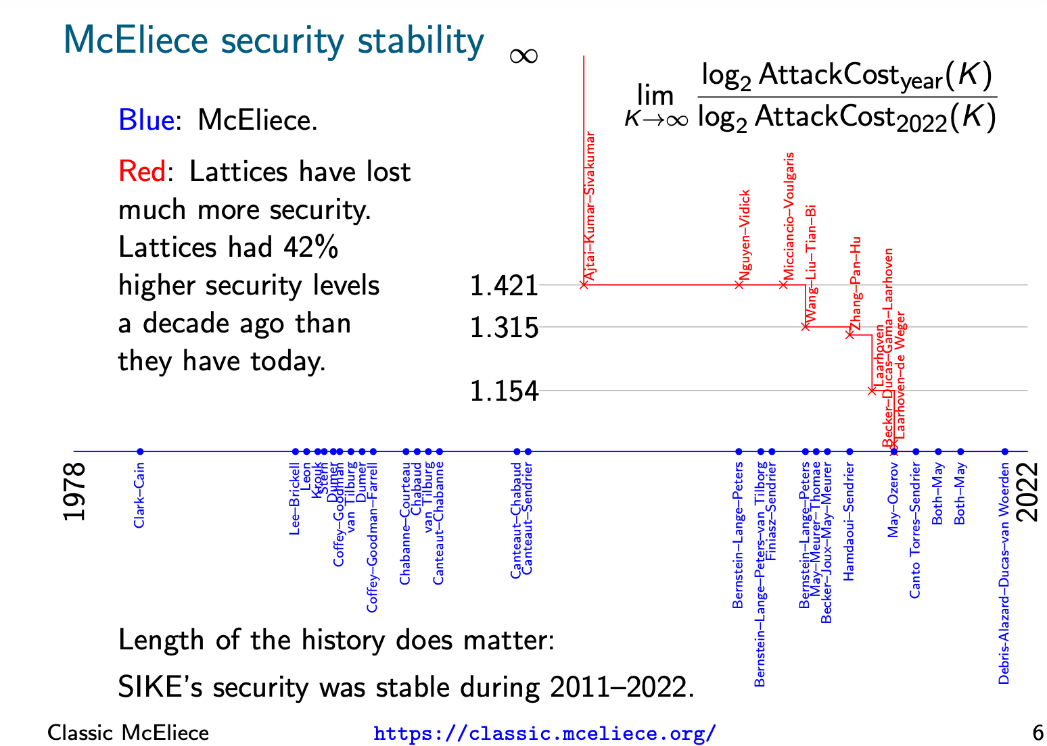

Slide 6
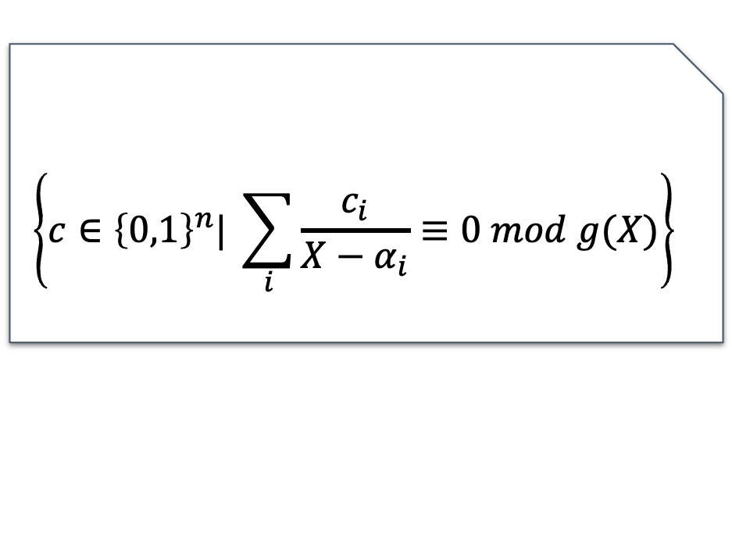
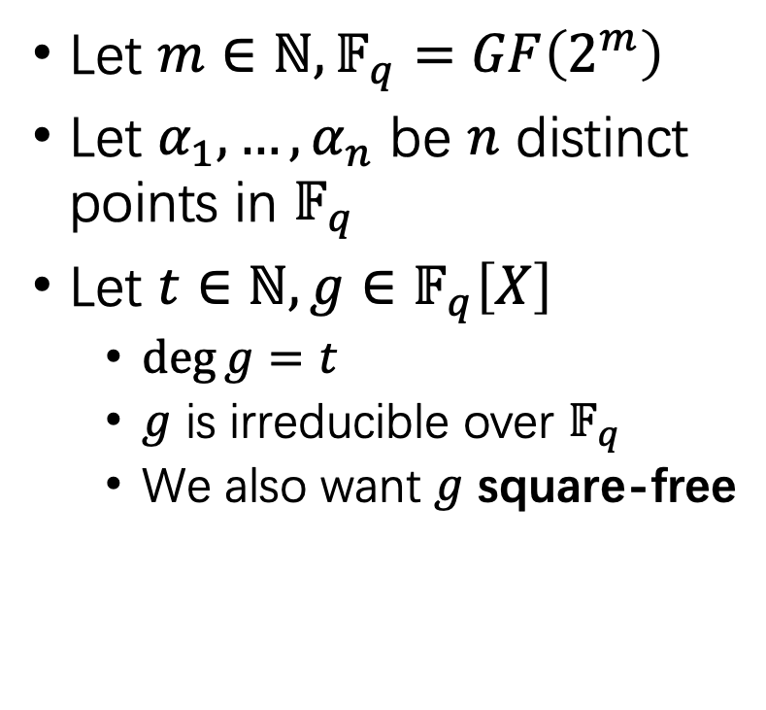

Binary Goppa Code: Definition
$$\left\{c∈{\left\{0,1\right\}}^{n}| \sum_{i}{\frac{c_{i}}{X−α_{i}}≡0 mod g(X)}\right\}$$
Let $m∈ℕ,𝔽_{q}=GF\left(2^{m}\right)$
Let $α_{1},…,α_{n}$ be $n$ distinct points in $𝔽_{q}$
Let $t∈ℕ,g∈𝔽_{q}\left[X\right]$
$\deg{g}=t$
$g$ is irreducible over $𝔽_{q}$
We also want $g$ square-free
Goppa Code: $Γ\left(g,α_{1},…,α_{n}\right)=$

Slide 7
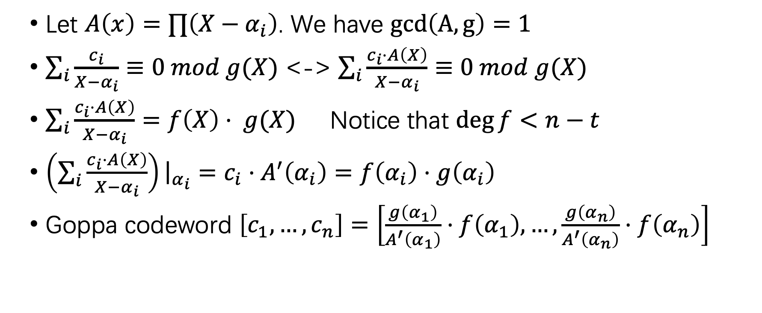
Binary Goppa Code: Relation to RS
Let $A\left(x\right)=∏\left(X−α_{i}\right)$. We have $gcd\left(A,g\right)=1$
$\sum_{i}{\frac{c_{i}}{X−α_{i}}≡0 mod g(X)}$ <-> $\sum_{i}{\frac{c_{i}⋅A\left(X\right)}{X−α_{i}}≡0 mod g(X)}$
$\sum_{i}{\frac{c_{i}⋅A\left(X\right)}{X−α_{i}}=f\left(X\right)⋅ g(X)}$ Notice that $\deg{f}<n−t$
$\left(\sum_{i}{\frac{c_{i}⋅A\left(X\right)}{X−α_{i}}}\right){\left.​\right|}_{α_{i}}=c_{i}⋅A^{′}\left(α_{i}\right)=f\left(α_{i}\right)⋅g\left(α_{i}\right)$
Goppa codeword $\left[c_{1},…,c_{n}\right]=\left[\frac{g\left(α_{1}\right)}{A^{′}\left(α_{1}\right)}⋅f\left(α_{1}\right),…,\frac{g\left(α_{n}\right)}{A^{′}\left(α_{n}\right)}⋅f\left(α_{n}\right)\right]$

Slide 8
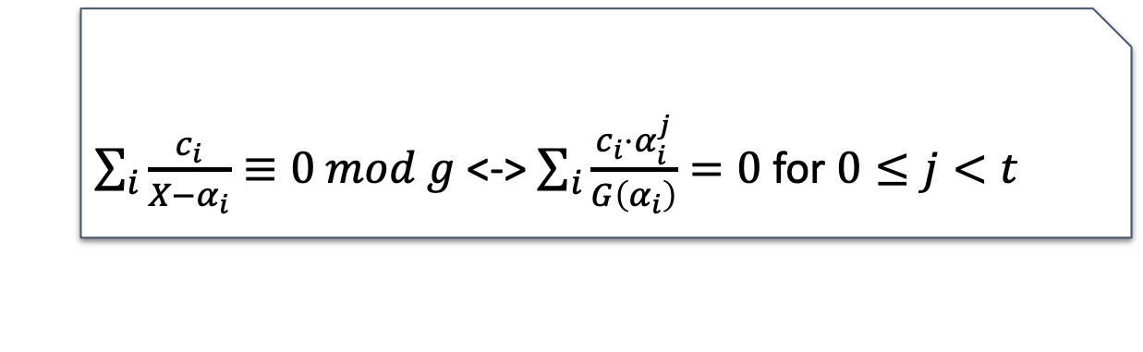
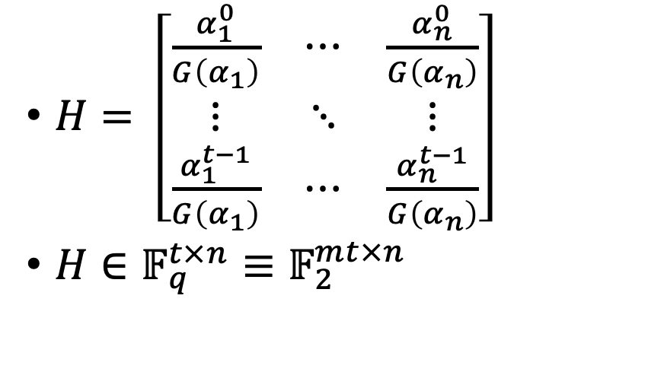
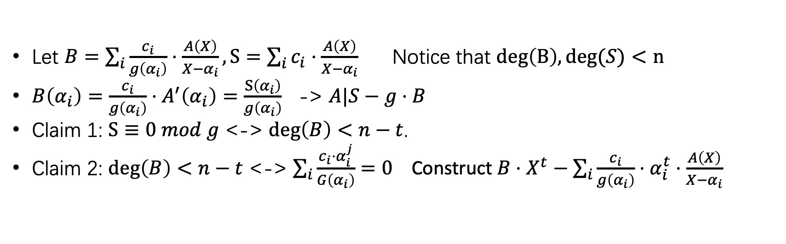
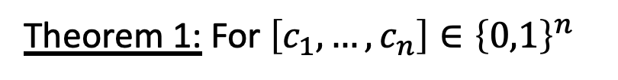
Binary Goppa Code: Parity Check
$H= \left[\begin{matrix}\frac{α_{1}^{0}}{G\left(α_{1}\right)} & ⋯ & \frac{α_{n}^{0}}{G\left(α_{n}\right)} \\ ⋮ & ⋱ & ⋮ \\ \frac{α_{1}^{t−1}}{G\left(α_{1}\right)} & ⋯ & \frac{α_{n}^{t−1}}{G\left(α_{n}\right)}\end{matrix}\right]$
$H∈𝔽_{q}^{t×n}≡𝔽_{2}^{mt×n}$
$\sum_{i}{\frac{c_{i}}{X−α_{i}}≡0 mod g}$ <-> $\sum_{i}{\frac{c_{i}⋅α_{i}^{j}}{G\left(α_{i}\right)}}=0$ for $0≤j<t$
Theorem 1: For $\left[c_{1},…,c_{n}\right]∈{\left\{0,1\right\}}^{n}$
Let $B=\sum_{i}{\frac{c_{i}}{g\left(α_{i}\right)}⋅\frac{A\left(X\right)}{X−α_{i}}}, S=\sum_{i}{c_{i}⋅\frac{A\left(X\right)}{X−α_{i}}}$ Notice that $deg\left(B\right),deg(S)<n$
$B\left(α_{i}\right)=\frac{c_{i}}{g\left(α_{i}\right)}⋅A^{′}\left(α_{i}\right)=\frac{S\left(α_{i}\right)}{g\left(α_{i}\right)}$ -> $A|S−g⋅B$
Claim 1: $S≡0 mod g$ <-> $deg\left(B\right)<n−t$.
Claim 2: $deg\left(B\right)<n−t$ <-> $\sum_{i}{\frac{c_{i}⋅α_{i}^{j}}{G\left(α_{i}\right)}}=0$ Construct $B⋅X^{t}−\sum_{i}{\frac{c_{i}}{g\left(α_{i}\right)}⋅α_{i}^{t}⋅\frac{A\left(X\right)}{X−α_{i}}}$

Slide 9
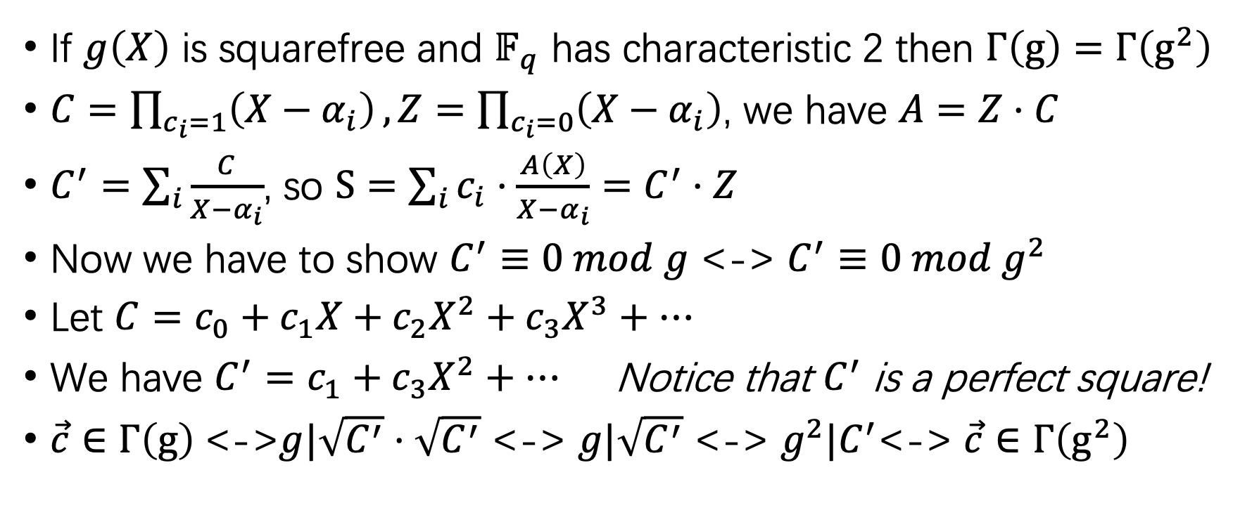
Binary Goppa Code: Square-free g(X)
If $g\left(X\right)$ is squarefree and $𝔽_{q}$ has characteristic 2 then $Γ\left(g\right)=$ $Γ\left(g^{2}\right)$
$C=\prod_{c_{i}=1}{\left(X−α_{i}\right)},Z=\prod_{c_{i}=0}{\left(X−α_{i}\right)}$, we have $A=Z⋅C$
$C^{′}=\sum_{i}{\frac{C}{X−α_{i}}}$, so $S=\sum_{i}{c_{i}⋅\frac{A\left(X\right)}{X−α_{i}}}=C^{′}⋅Z$
Now we have to show $C^{′}≡0 mod g$ <-> $C^{′}≡0 mod g^{2}$
Let $C=c_{0}+c_{1}X+c_{2}X^{2}+c_{3}X^{3}+…$
We have $C^{′}=c_{1}+c_{3}X^{2}+…$ Notice that $C^{′}$ is a perfect square!
$\vec{c}∈Γ\left(g\right)$<->$g|\sqrt{C^{′}}⋅\sqrt{C^{′}}$ <-> $g|\sqrt{C^{′}}$ <-> $g^{2}|C^{′}$<-> $\vec{c}∈Γ\left(g^{2}\right)$

Slide 10
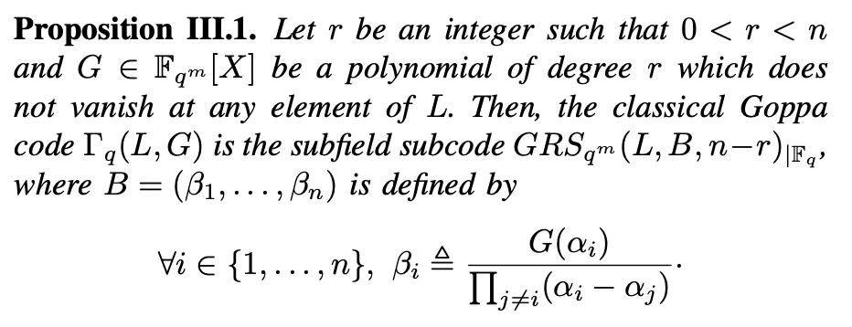
Unique Decoding Algorithm 1
Use RS-Code decoder

Slide 11
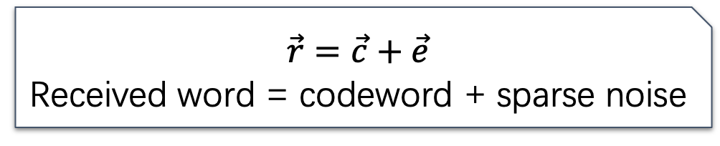
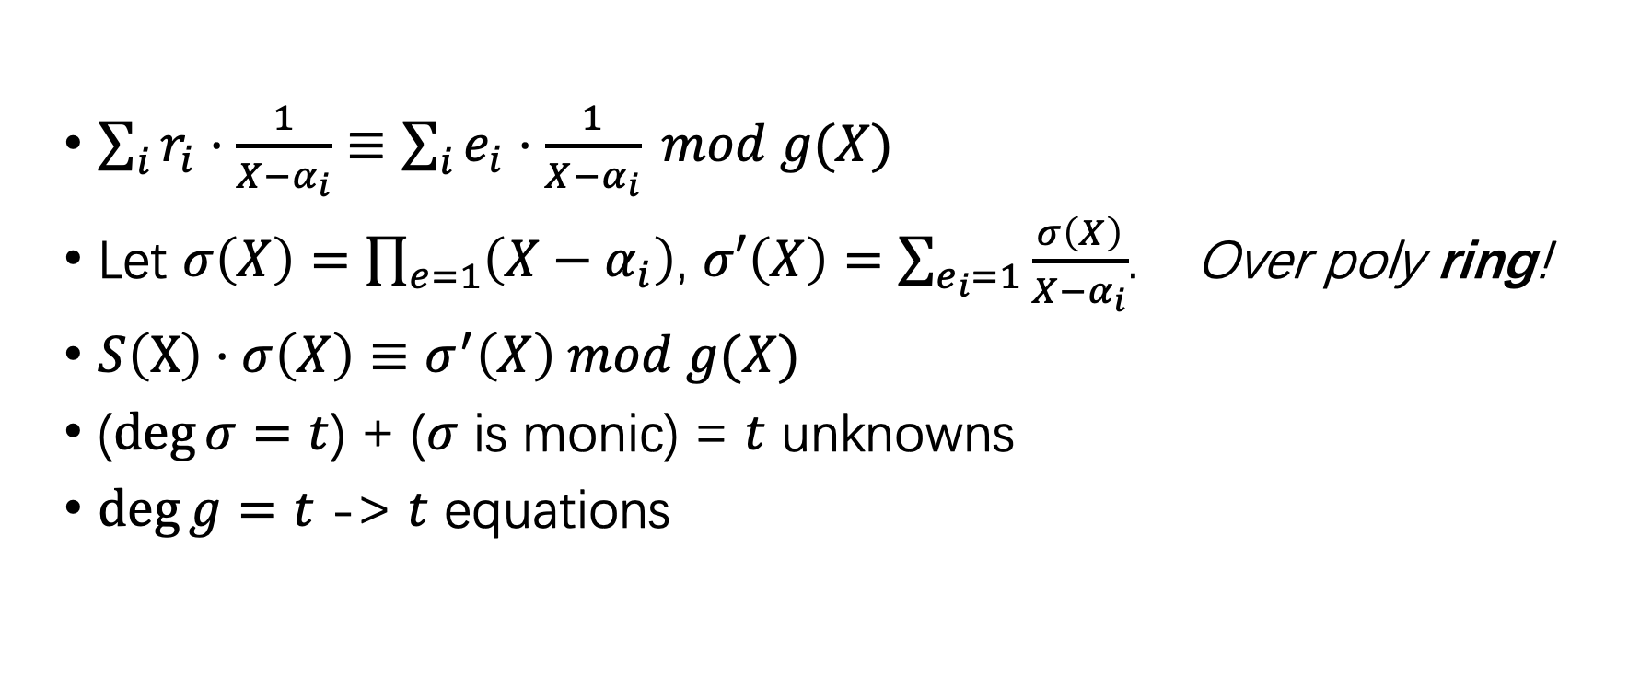


Algorithm 2
$$\vec{r}=\vec{c}+\vec{e}$$
Received word = codeword + sparse noise
$$S\left(X\right)$$
$$E\left(X\right)$$
$\sum_{i}{r_{i}⋅\frac{1}{X−α_{i}}}≡$ $\sum_{i}{e_{i}⋅\frac{1}{X−α_{i}}} mod g(X)$
Let $σ\left(X\right)=\prod_{e=1}{\left(X−α_{i}\right)}$, $σ′\left(X\right)=$ $\sum_{e_{i}=1}{\frac{σ\left(X\right)}{X−α_{i}}}$. Over poly ring!
$S\left(X\right)⋅σ\left(X\right)≡σ^{′}\left(X\right) mod g(X)$
($\deg{σ}=t$) + ($σ$ is monic) = $t$ unknowns
$\deg{g}=t$ -> $t$ equations

Slide 12
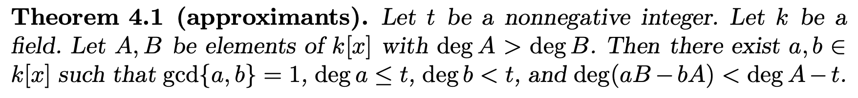
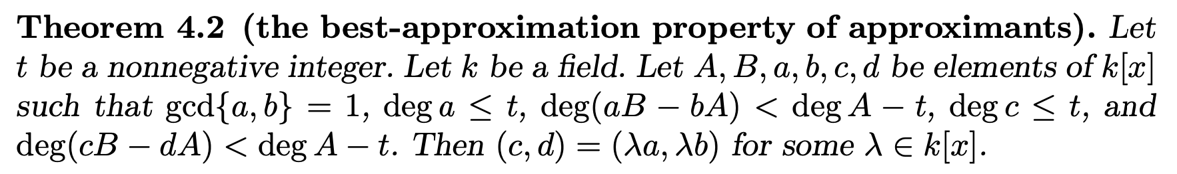
Algorithm 3

Slide 13
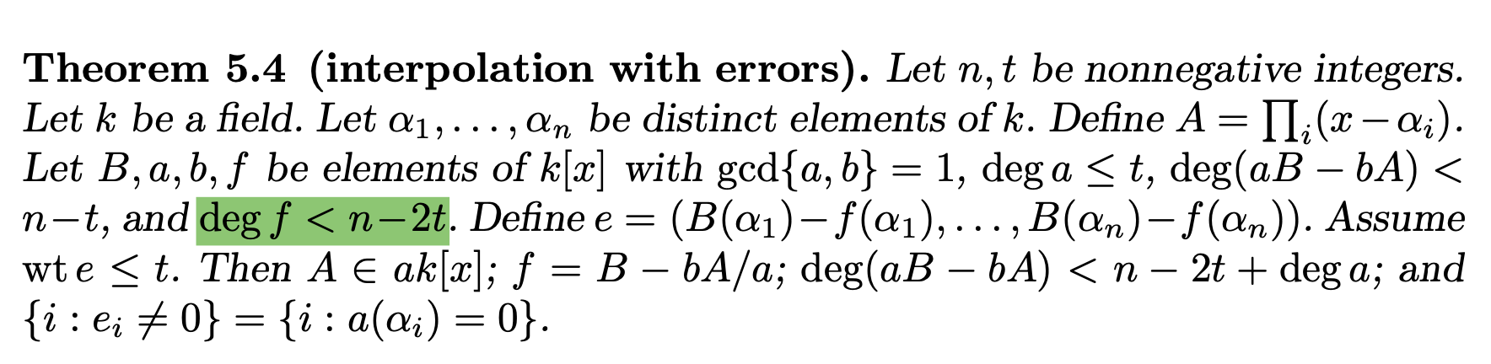
Algorithm 3: Interpolation with error

Slide 14
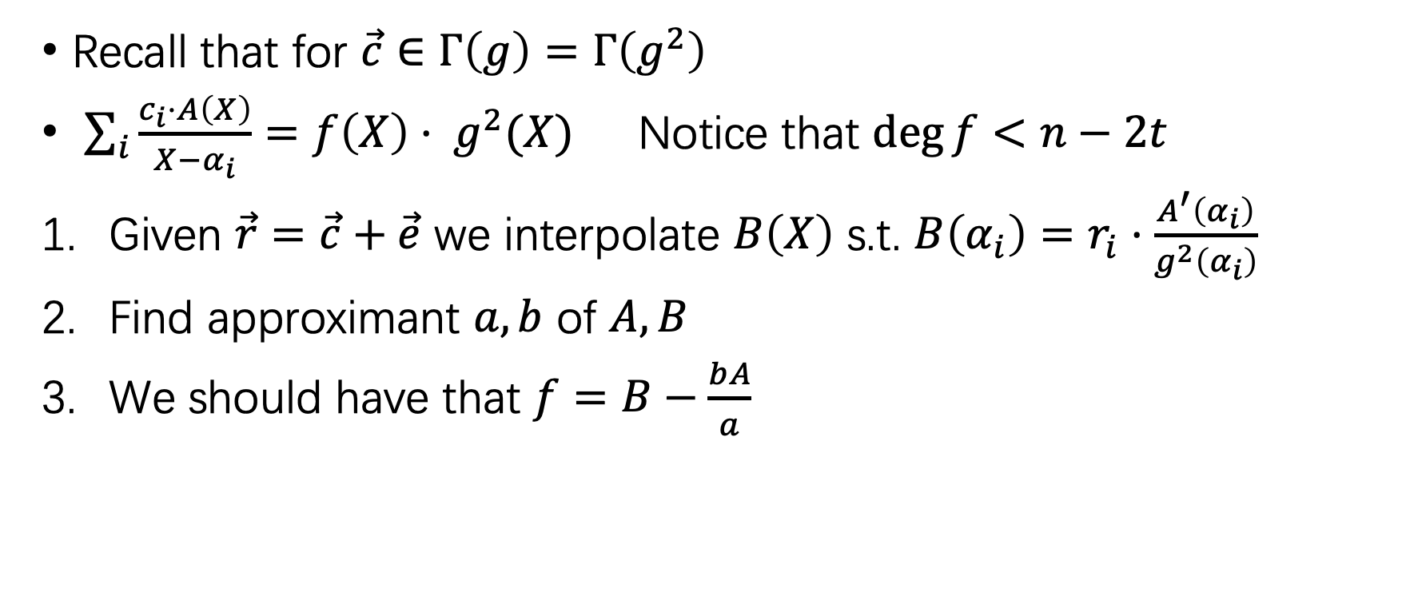
Algorithm 3
Recall that for $\vec{c}∈Γ\left(g\right)=Γ\left(g^{2}\right)$
$\sum_{i}{\frac{c_{i}⋅A\left(X\right)}{X−α_{i}}=f\left(X\right)⋅ g^{2}(X)}$ Notice that $\deg{f}<n−2t$
Given $\vec{r}=\vec{c}+\vec{e}$ we interpolate $B\left(X\right)$ s.t. $B\left(α_{i}\right)=r_{i}⋅\frac{A^{′}\left(α_{i}\right)}{g^{2}\left(α_{i}\right)}$
Find approximant $a,b$ of $A,B$
We should have that $f=B−\frac{bA}{a}$

Slide 15
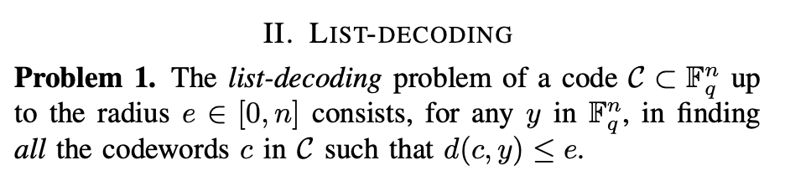
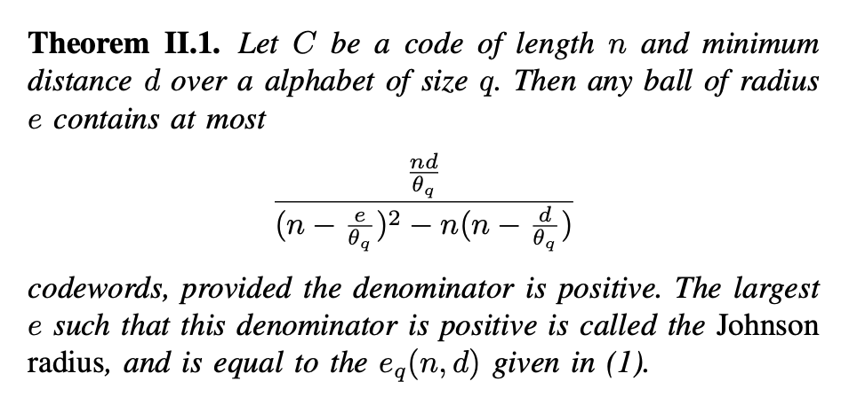
List Decoding and Johnson’s Bound
Definition
Johnson’s Bound:

Slide 16
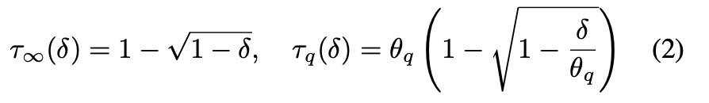
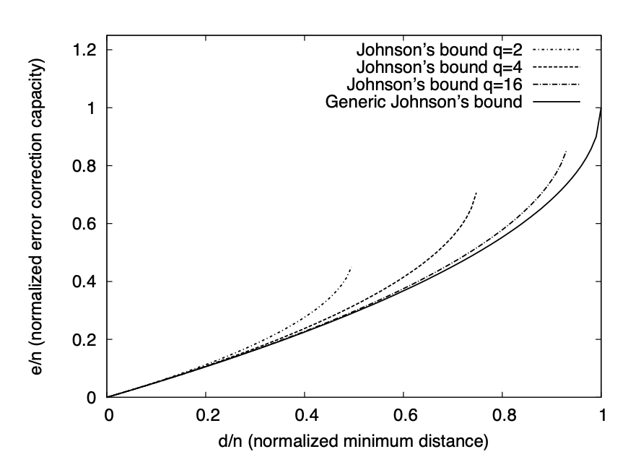
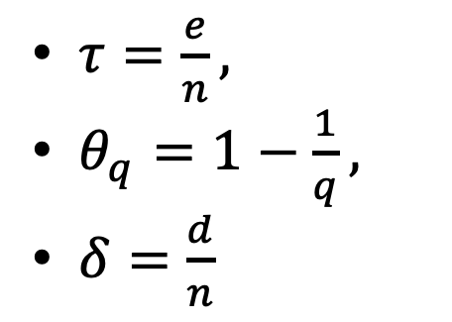
More on Johnson’s Bound
$τ=\frac{e}{n},$
$θ_{q}=1−\frac{1}{q},$
$δ=\frac{d}{n}$
Parameter | t | Johnson | GV
51220 | 20 | 21 | 36
348864 | 64 | 65 | 126

Slide 17
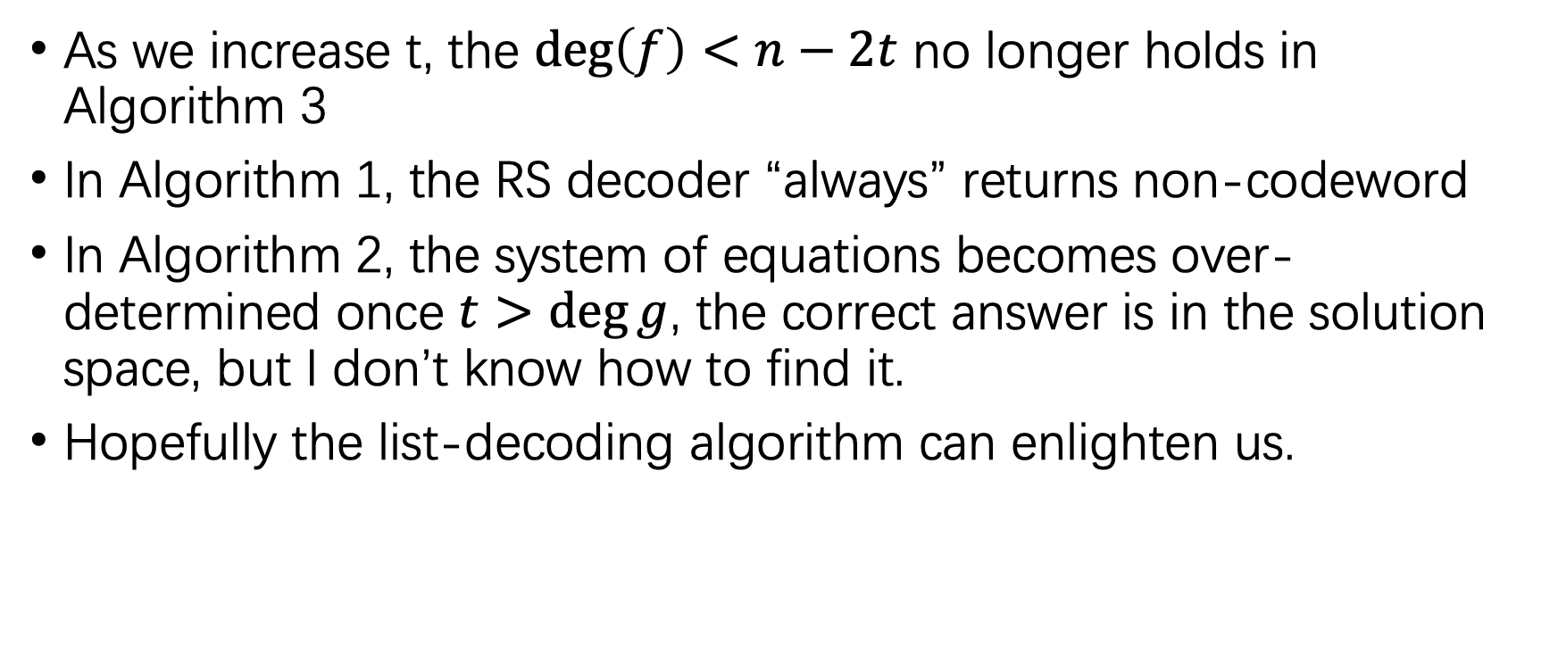
Issues with extending the error bound
As we increase t, the $\deg\left(f\right)<n−2t$ no longer holds in Algorithm 3
In Algorithm 1, the RS decoder “always” returns non-codeword
In Algorithm 2, the system of equations becomes over-determined once $t>\deg{g}$, the correct answer is in the solution space, but I don’t know how to find it.
Hopefully the list-decoding algorithm can enlighten us.

Slide 18
Reference
[1] E. Berlekamp, “Goppa codes,” IEEE Transactions on Information Theory, vol. 19, no. 5, pp. 590–592, Sep. 1973, doi: 10.1109/TIT.1973.1055088.
[2] D. J. Bernstein, “Understanding binary-Goppa decoding”.
[3] D. Augot, M. Barbier, and A. Couvreur, “List-Decoding of Binary Goppa Codes up to the Binary Johnson Bound”.
[4] N. T. Courtois, M. Finiasz, and N. Sendrier, “How to Achieve a McEliece-Based Digital Signature Scheme,” in Advances in Cryptology — ASIACRYPT 2001, vol. 2248, C. Boyd, Ed., in Lecture Notes in Computer Science, vol. 2248. , Berlin, Heidelberg: Springer Berlin Heidelberg, 2001, pp. 157–174. doi: 10.1007/3-540-45682-1_10.
[5] R. J. McEliece, “A public-key cryptosystem based on algebraic,” Coding Thv, vol. 4244, pp. 114–116, 1978.

